Slide 1
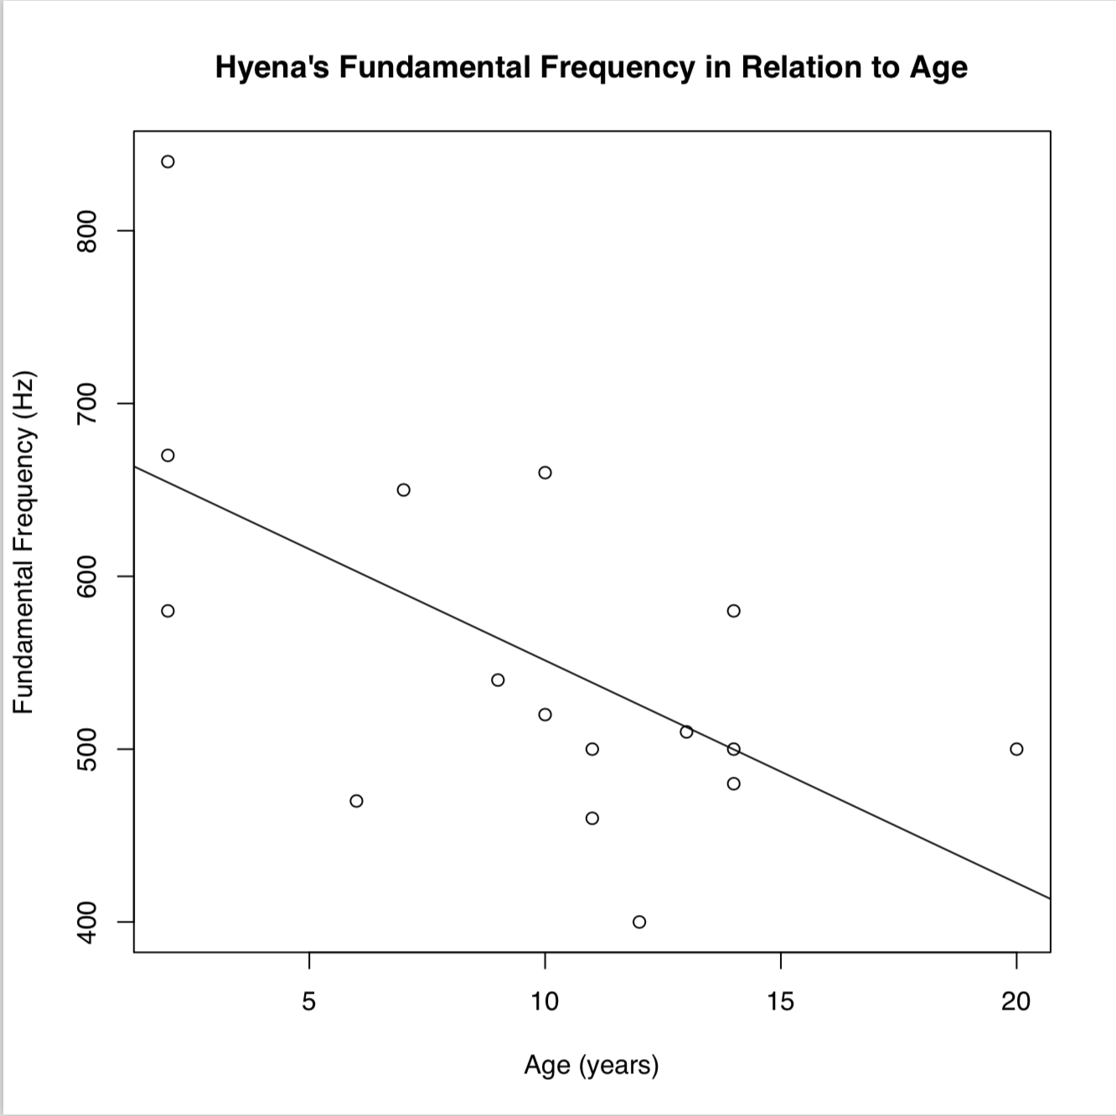
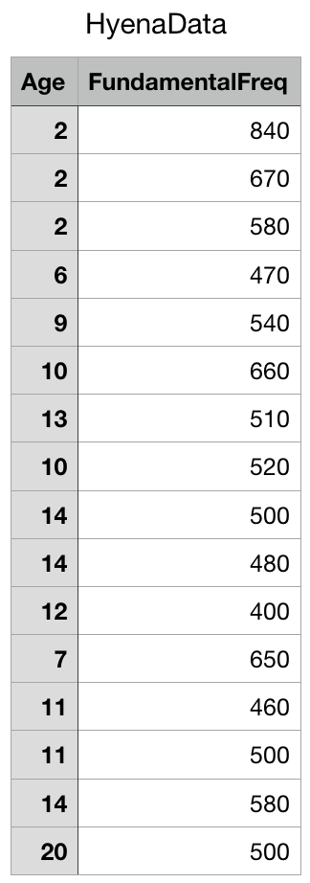
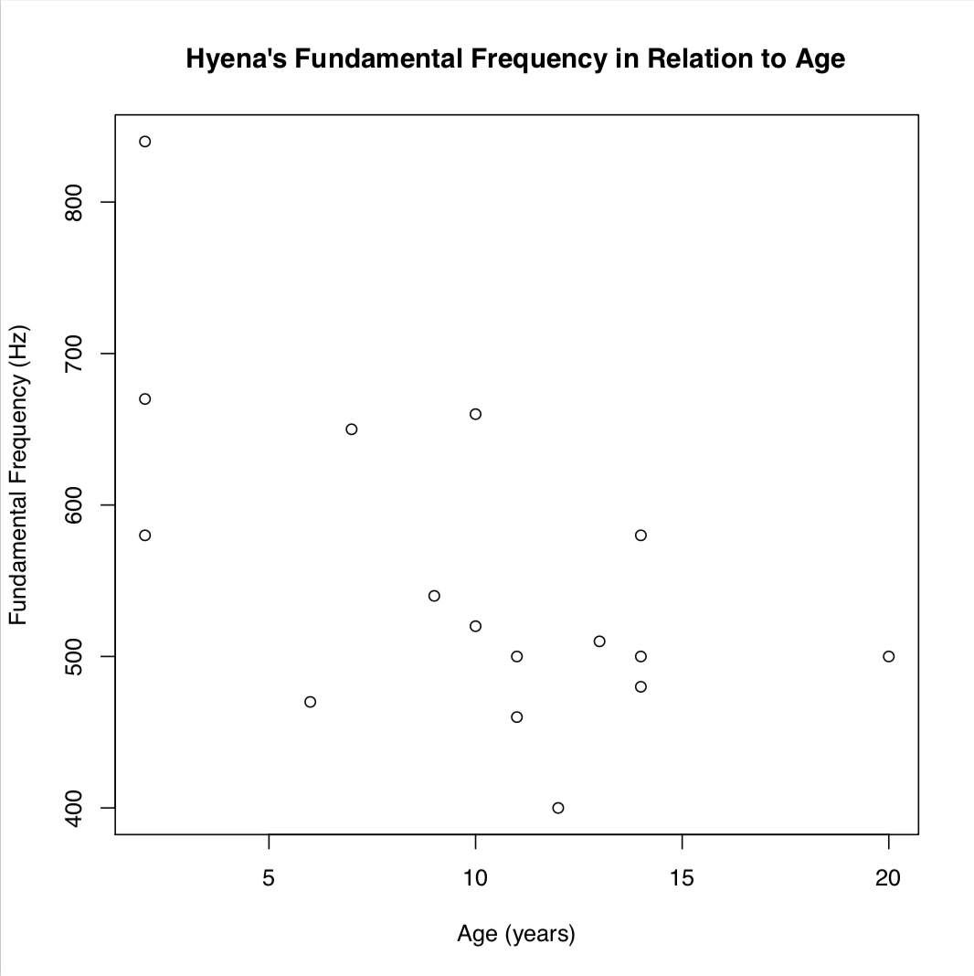
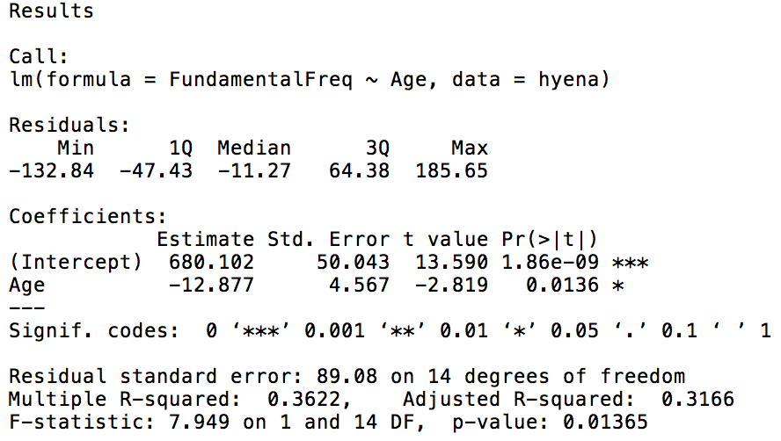
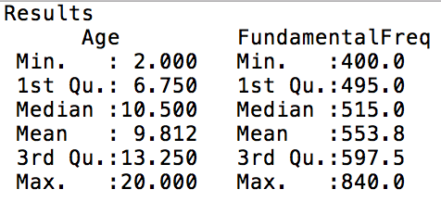
Linear Regression Analysis of Hyena Giggle Fundamental Frequency Versus Age
Shivani Pandya
Biostatistics Final Presentation
Introduction
Conclusions
Hyenas, famously, laugh (Whitlock and Schluter). Mathevon et al. 2010 researched several aspects of hyena giggles. One of these studies included measuring spectral properties of these giggles. This study investigated 16 hyenas and compared their fundamental frequencies to their ages (Fig. 1).
Figure 3. Sample data plotted with line of best fit.
Since the p-value is less than our alpha value of 0.05, we can reject the null hypothesis that the slope of the regression of hyena sound spectral properties and their age is zero. We can conclude that there is some type of nonzero relationship between hyena laughter fundamental frequency and their age.
Sample Details
Regression Analysis
A.
B.
The type of test used in this analysis is a one sample t-test using the slope of regression. The summary of the regression analysis highlights the slope and intercept of the least squares regression line, as well as the t test statistic and p-value.
The regression summary shows that the t test statistic is -2.819 (Fig. 2), which has an absolute value greater than the critical value of 2.14 from the t-distribution (with degrees of freedom that are 16-2=14). The p-value is 0.0136. Our alpha level value is 0.05.
This data set was taken from Practice Problem 1 in Chapter 16 of Whitlock and Schluter’s “The Analysis of Biological Data.”
The sample size for this data is 16. There are two continuous numerical variables: age, which is measured in years, and fundamental frequency, which is measured in hertz.
Purpose
C.
Figure 1. a. Sample Data of hyena study. b. Sample data plotted. c. Summary of sample data.
Scientific question being asked in this analysis:
Is there a linear relationship between age of hyena and fundamental frequency of hyena laughter?
The null and alternative hypotheses
Ho: the slope of the regression of hyena sound spectral properties and their age is zero (β=0).
Ha: the slope of the regression of hyena sound spectral properties and their age is not zero (β≠0).
Figure 2. Regression Summary
Github repository link: https://github.com/sdp43/BioStatsFinalProject
References:
Whitlock, Michael, and Dolph Schluter. The Analysis of Biological Data. Macmillan Education, 2015.

